Slide 1
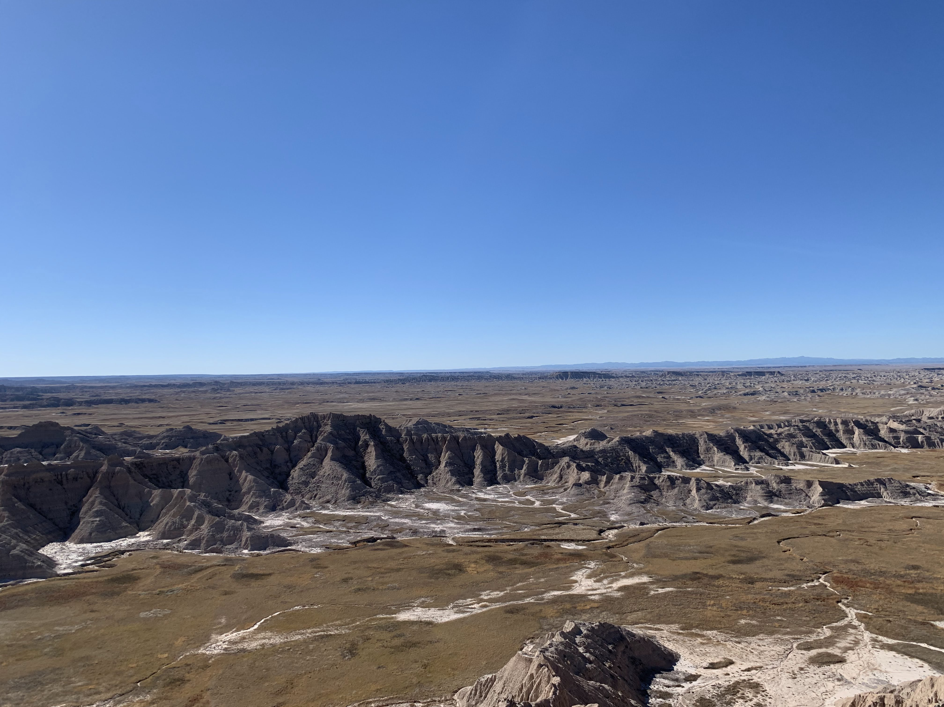
Writing Profile: Day #7
Crafting Interview Questions

Slide 2

Homework
Read “Polaroids,” “Character,” & “’Tantalizing’ decay of nature’s rarest isotope may finally be within reach”
Professional email, upload to dropbox, 10-15 questions for interview (Journal #5)
Set up interview

Slide 3

Pre-Interview Question Tips
Prewrite before the interview:
1. How would I define or describe the interviewee and profession?
2. What will be the purpose for my profile?
3. What about the subject will interest me and my readers?
5. What do I hope to learn through the interview?

Slide 4
Tips for Crafting Interview Questions
You will want more open ended than closed ended questions.
Open: What is an average day like for you?
Closed: Do you like training herding dogs?
Draft ten questions and make sure there is a theme to the questions.
Ask for stories.
Tell me about a time when you trained a very aggressive dog.
Let subjects correct misconceptions.
What misconceptions do people have coming into your basic dog training class?
What breed of dog is largely misunderstood? Why?

Slide 5
Continued
Ask about the subject’s past and future:
How has dog training changed over the twenty years you’ve been training?
What do you want to do when you retire from Happy Tails?

Slide 6
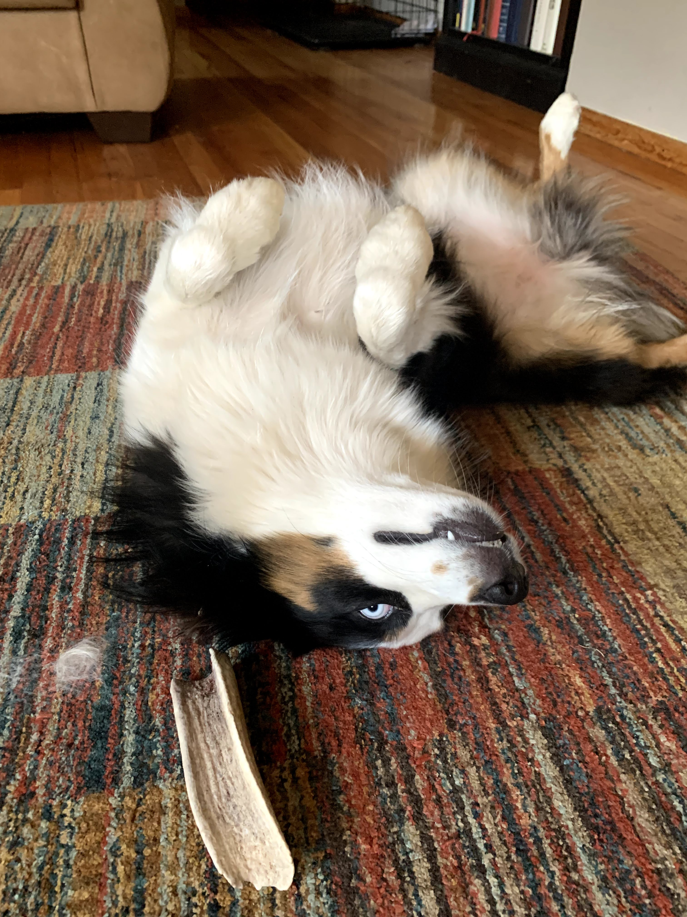
Example Questions
Find statistics about your topic:
How many dogs are re-homed/year?
How has Covid affected your subject?
How has Covid affected dog ownership?
What are some burning questions you and your audience will want to know about your subject?
Can dogs who are fearful and aggressive be rehabilitated?
How does a dog’s breed complicate training?
What do animal shelters want people to know about canine friends?
What are the advantages of getting a mutt vs. pure breed?
When people think of dog trainers, they think of people like Cesar Milan? What do you think about the paradigm for dog training?
Have you ever had an experience when you wished that you could rehabilitate the dog, but you could not? What happened?

Slide 7
Journal #5
In our reading in Bird by Bird, Lamott gives some suggestions on how to create a “polaroid” of a situation or context and also how to show a believable character. What techniques resonated with you? How will you apply these techniques to the profile?
List out your interview questions for journal #5. If you would like my feedback on your questions, please upload them to the dropbox early. This will still be counted for a journal entry, but I will look at them before Friday.

